Slide 1
Chapter 4: Multivariate state-space models for animal movement

Slide 2
Multivariate models
Problem:
Dynamics often involve multiple variables
Examples:
Individual movement in 2+ dimensions
Spatial location (usually) requires 2-3 dimensions
Population dynamics for 2+ species
Community / ecosystem models
Demographic population models
Age/length/sex structured models track abundance for different stages

Slide 3
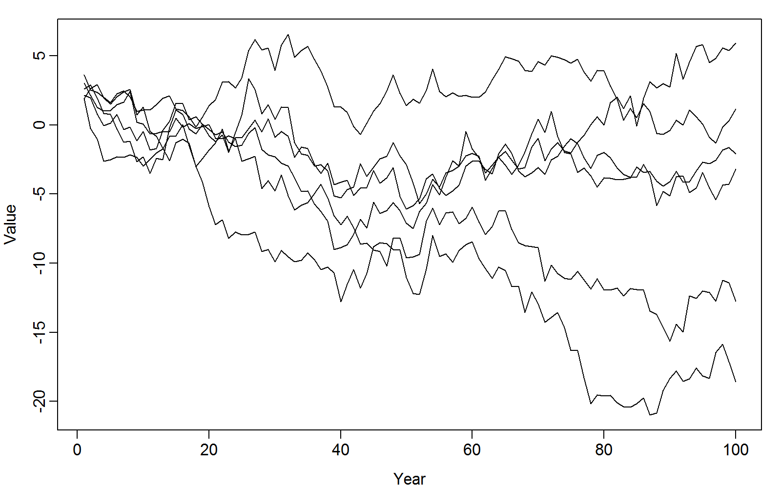

Multivariate models
Given timeseries from multiple populations…
Dynamical process: $x_{c,t+1}=x_{c,t}+ε_{c,t}+δ_{t}$
Individual effect: $ε_{c,t}\sim Normal(0,τ^{2})$
Shared effect: $δ_{t}\sim Normal\left(0,σ^{2}\right)$
Observation process: $y_{c,t}\sim Normal(x_{c,t},u^{2})$

Slide 4
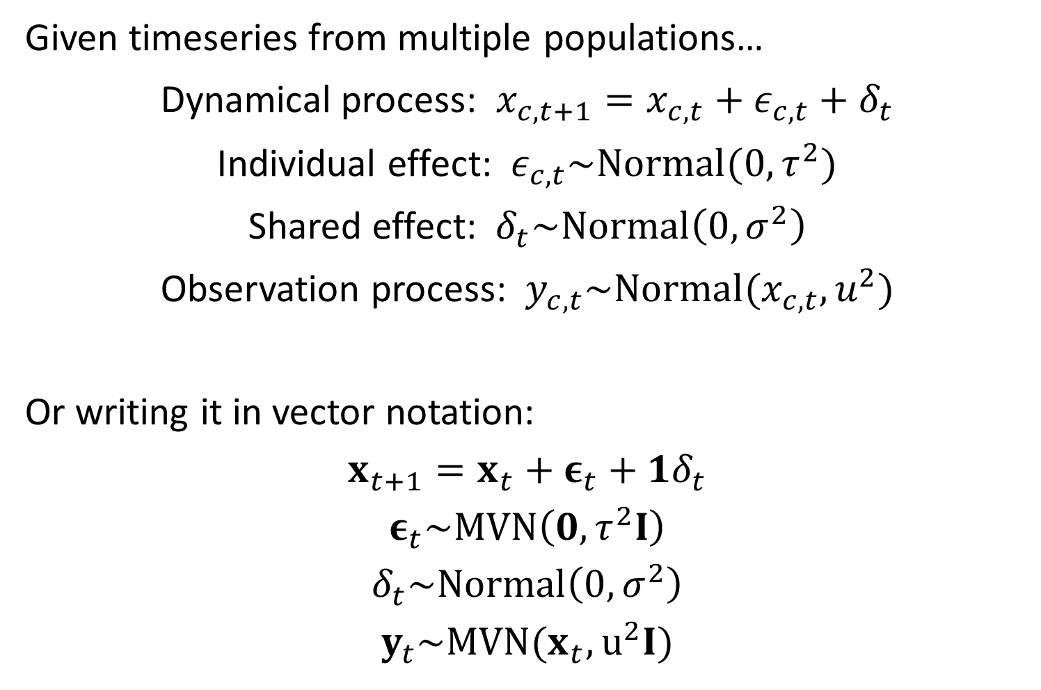
Multivariate models
Given timeseries from multiple populations…
Dynamical process: $x_{c,t+1}=x_{c,t}+ε_{c,t}+δ_{t}$
Individual effect: $ε_{c,t}\sim Normal(0,τ^{2})$
Shared effect: $δ_{t}\sim Normal\left(0,σ^{2}\right)$
Observation process: $y_{c,t}\sim Normal(x_{c,t},u^{2})$
Or writing it in vector notation:
$$x_{t+1}=x_{t}+ε_{t}+1δ_{t}$$
$$ε_{t}\sim MVN\left(0,τ^{2}I\right)$$
$$δ_{t}\sim Normal\left(0,σ^{2}\right)$$
$$y_{t}\sim MVN(x_{t},u^{2}I)$$

Slide 5
Multivariate models
Questions:
How to tell if populations have positively correlated dynamics?
What is the average trend?
How to forecast future changes?
Is there density dependence (tendency to revert to a stationary distribution)
How to incorporate hypotheses about which variables are more or less correlated

Slide 6
Multivariate models
Approaches to think about covariance:
Sum of covariances (“variance partitioning”)
Eigen-decomposition (“principal components analysis”)
Elementary ways to specify variance
Diagonal and equal
Diagonal and unequal
Cholesky decomposition (“factor model”)
Simultaneous equation model (“structural equation model”)

Slide 7
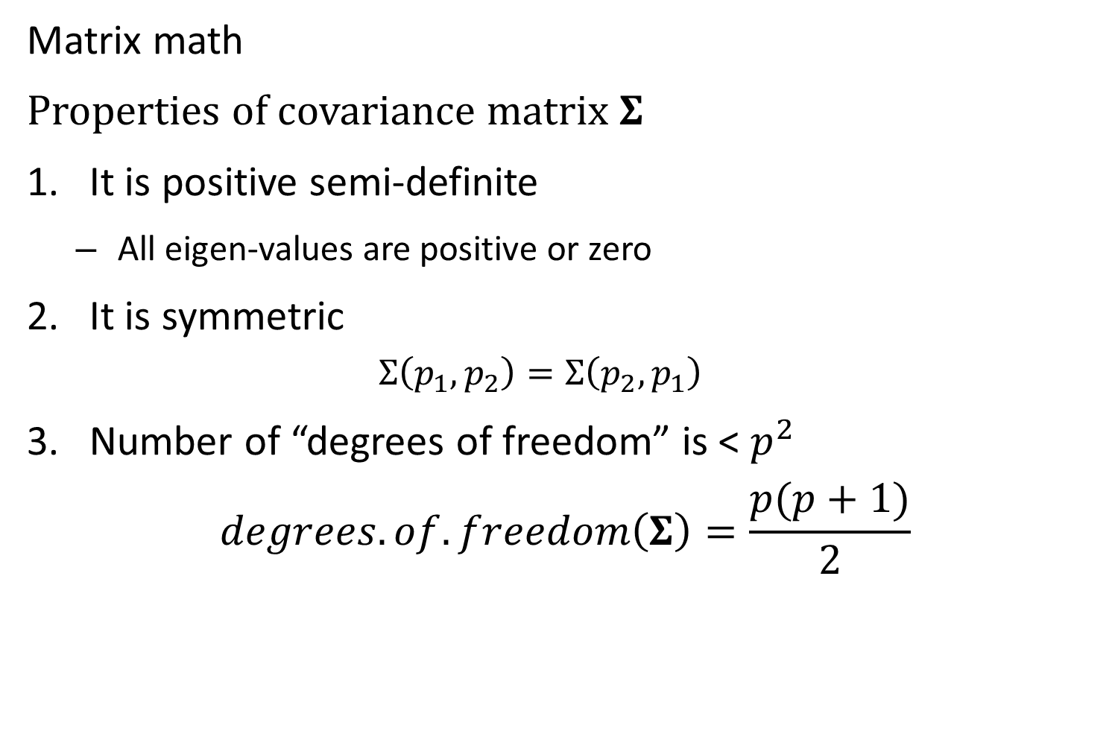
Multivariate models
Matrix math
Properties of covariance matrix $Σ$
It is positive semi-definite
All eigen-values are positive or zero
It is symmetric
$$Σ\left(p_{1},p_{2}\right)=Σ\left(p_{2},p_{1}\right)$$
Number of “degrees of freedom” is < $p^{2}$
$$degrees.of.freedom\left(Σ\right)=\frac{p(p+1)}{2}$$

Slide 8
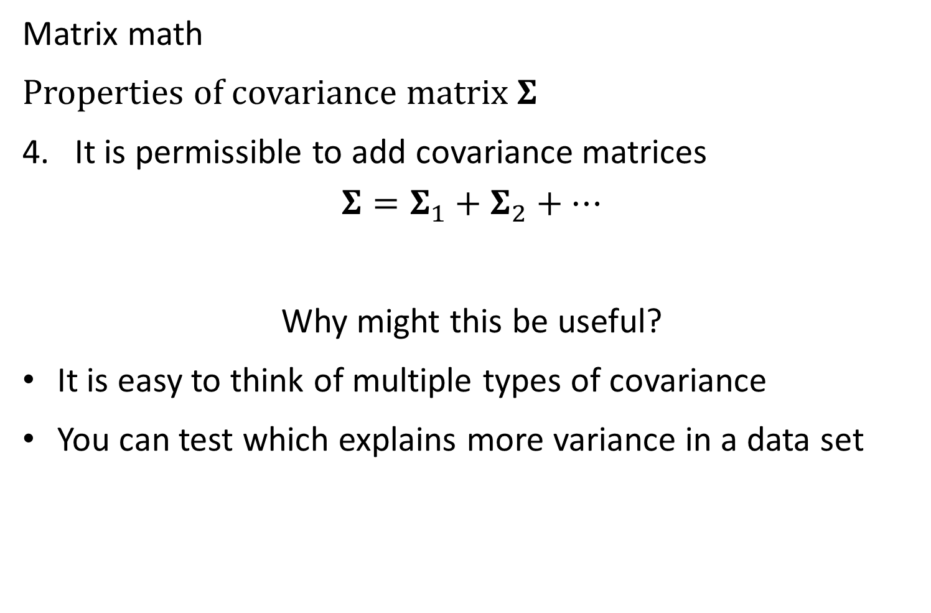
Multivariate models
Matrix math
Properties of covariance matrix $Σ$
It is permissible to add covariance matrices
$$Σ=Σ_{1}+Σ_{2}+…$$
Why might this be useful?
It is easy to think of multiple types of covariance
You can test which explains more variance in a data set

Slide 9
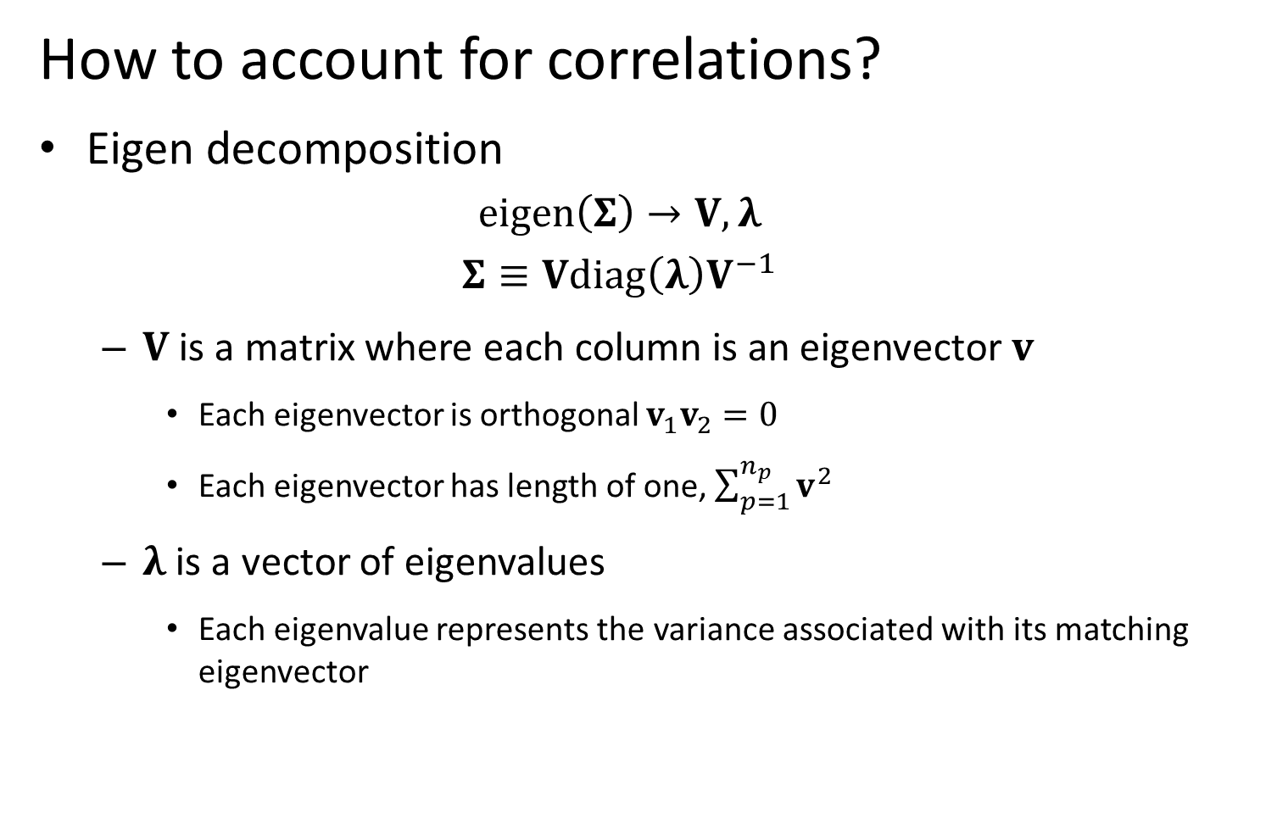
Multivariate models
How to account for correlations?
Eigen decomposition
$$eigen\left(Σ\right)→V,λ$$
$$Σ≡Vdiag\left(λ\right)V^{−1}$$
$V$ is a matrix where each column is an eigenvector $v$
Each eigenvector is orthogonal $v_{1}v_{2}=0$
Each eigenvector has length of one, $\sum_{p=1}^{n_{p}}{v^{2}}$
$λ$ is a vector of eigenvalues
Each eigenvalue represents the variance associated with its matching eigenvector
Notes:
Predicting rare/undersampled species, bycatch etc.

Slide 10
Multivariate models
Why is the eigendecomposition useful?
Check that the covariance is “admissible” (positive semi-definite)
Visualize dominant axes of variation
Notes:
Predicting rare/undersampled species, bycatch etc.

Slide 11
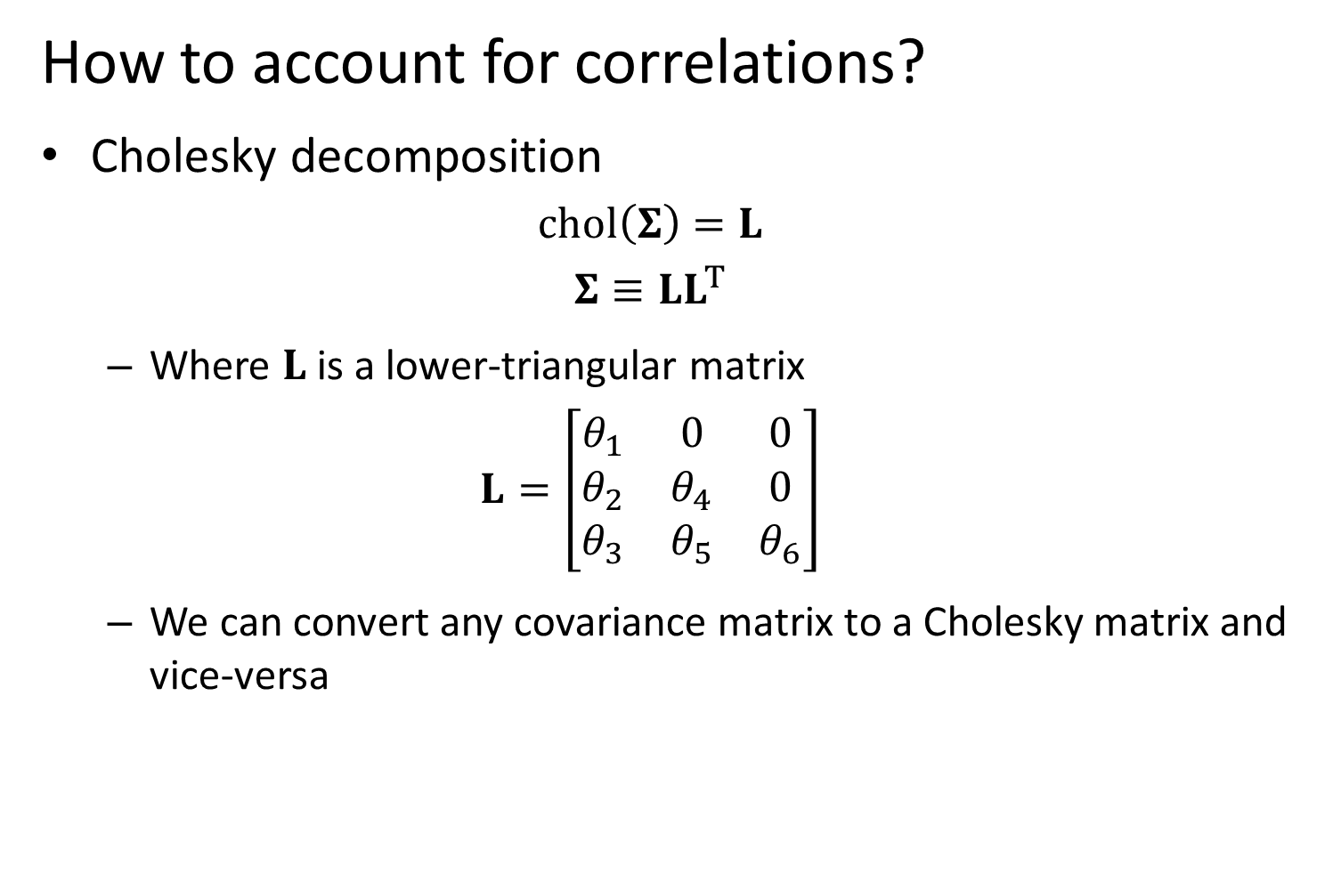
Multivariate models
How to account for correlations?
Cholesky decomposition
$$chol\left(Σ\right)=L$$
$$Σ≡LL^{T}$$
Where $L$ is a lower-triangular matrix
$$L=\left[\begin{matrix}θ_{1} & 0 & 0 \\ θ_{2} & θ_{4} & 0 \\ θ_{3} & θ_{5} & θ_{6}\end{matrix}\right]$$
We can convert any covariance matrix to a Cholesky matrix and vice-versa
Notes:
Predicting rare/undersampled species, bycatch etc.

Slide 12
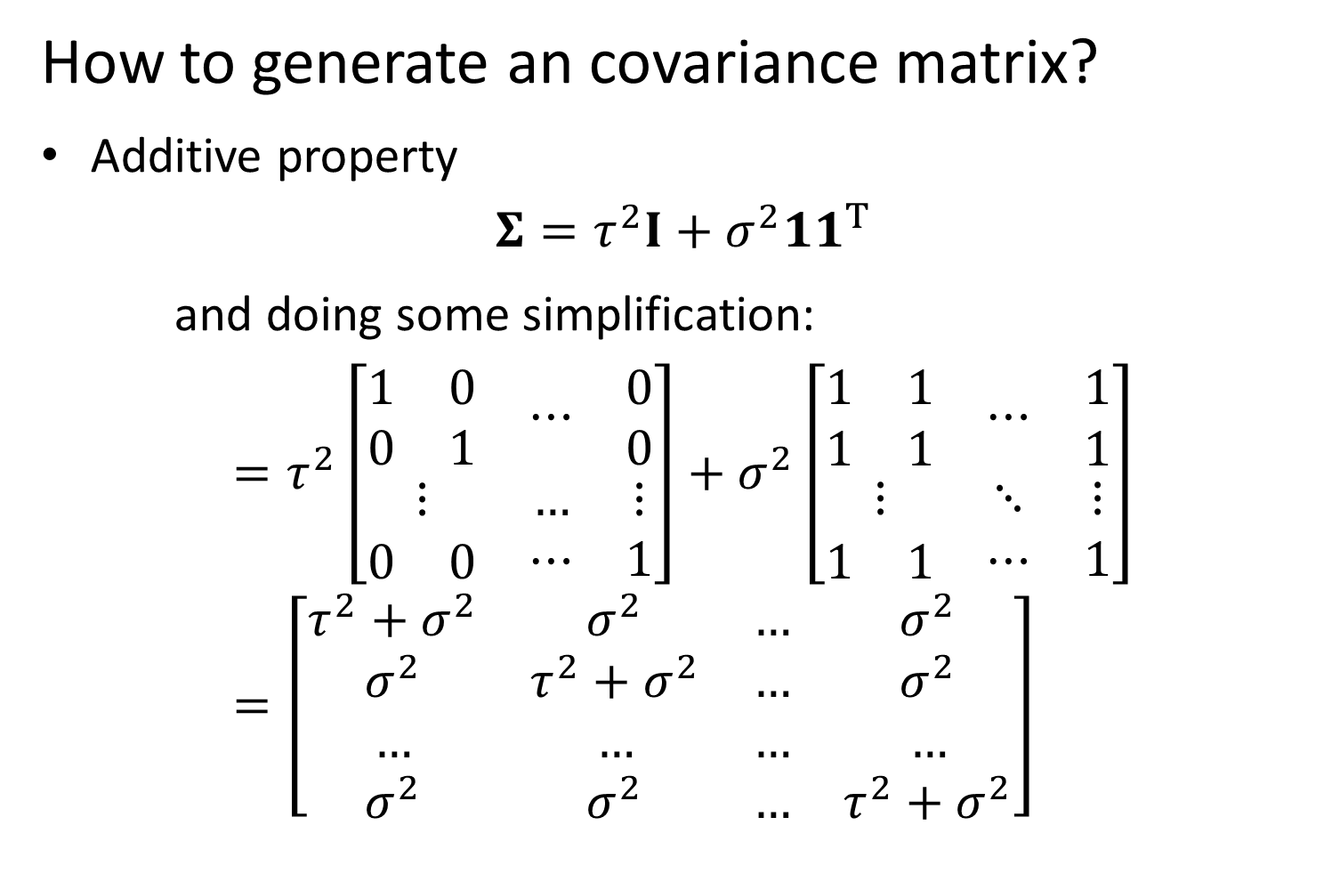
Multivariate models
How to generate an covariance matrix?
Additive property
$$Σ=τ^{2}I+σ^{2}11^{T}$$
and doing some simplification:
$$=τ^{2}\left[\begin{matrix}\begin{matrix}1 & 0 \\ 0 & 1\end{matrix} & ⋯ & \begin{matrix}0 \\ 0\end{matrix} \\ ⋮ & … & ⋮ \\ \begin{matrix}0 & 0\end{matrix} & ⋯ & 1\end{matrix}\right]+σ^{2}\left[\begin{matrix}\begin{matrix}1 & 1 \\ 1 & 1\end{matrix} & ⋯ & \begin{matrix}1 \\ 1\end{matrix} \\ ⋮ & ⋱ & ⋮ \\ \begin{matrix}1 & 1\end{matrix} & ⋯ & 1\end{matrix}\right] \\ =\left[\begin{matrix}τ^{2}+σ^{2} & σ^{2} & … & σ^{2} \\ σ^{2} & τ^{2}+σ^{2} & … & σ^{2} \\ … & … & … & … \\ σ^{2} & σ^{2} & … & τ^{2}+σ^{2}\end{matrix}\right]$$
Notes:
Predicting rare/undersampled species, bycatch etc.

Slide 13

Multivariate models
Simultaneous equation model:
$$x=Γx+δ$$
$$δ\sim MVN(0,V)$$
Then re-arranging:
$$\left(I−Γ\right)x=δ \\ x={\left(I−Γ\right)}^{−1}δ$$
So:
$$x\sim MVN\left(0,{\left(I−Γ\right)}^{−1}V{\left({\left(I−Γ\right)}^{−1}\right)}^{t}\right)$$

Slide 14

Community distribution models
Univariate random variable:
If
$$A\sim Normal(0,σ^{2})$$
Then
$$Var\left(cA\right)=c^{2}σ^{2}$$
Multivariate random variable
If
$$ε\sim MVN(0,Σ)$$
Then
$$Var\left(Lε\right)=LΣL^{t}$$
Notes:
Predicting rare/undersampled species, bycatch etc.

Slide 15
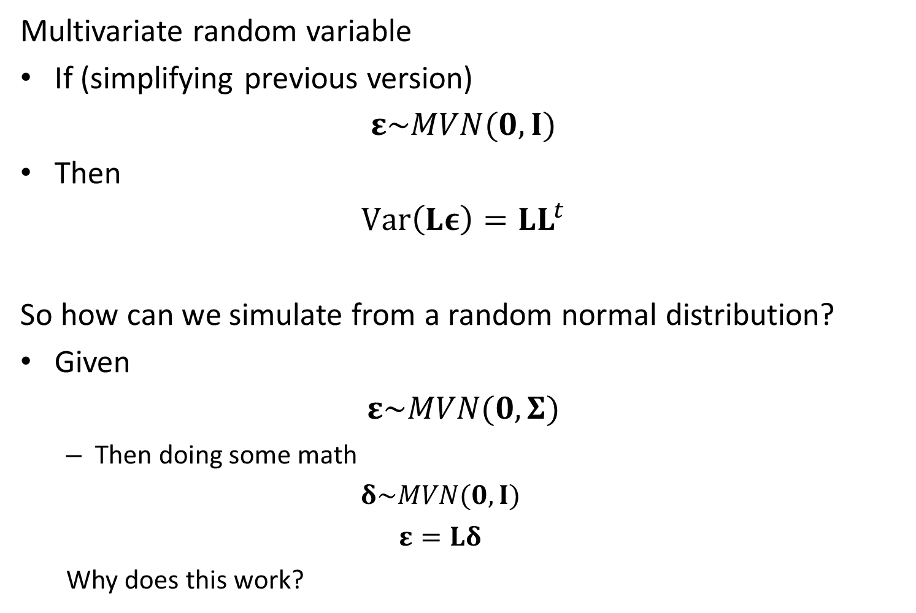
Community distribution models
Multivariate random variable
If (simplifying previous version)
$$ε\sim MVN(0,I)$$
Then
$$Var\left(Lε\right)=LL^{t}$$
So how can we simulate from a random normal distribution?
Given
$$ε\sim MVN(0,Σ)$$
Then doing some math
$$δ\sim MVN(0,I)$$
$$ε=Lδ$$
Why does this work?
Notes:
Predicting rare/undersampled species, bycatch etc.

Slide 16
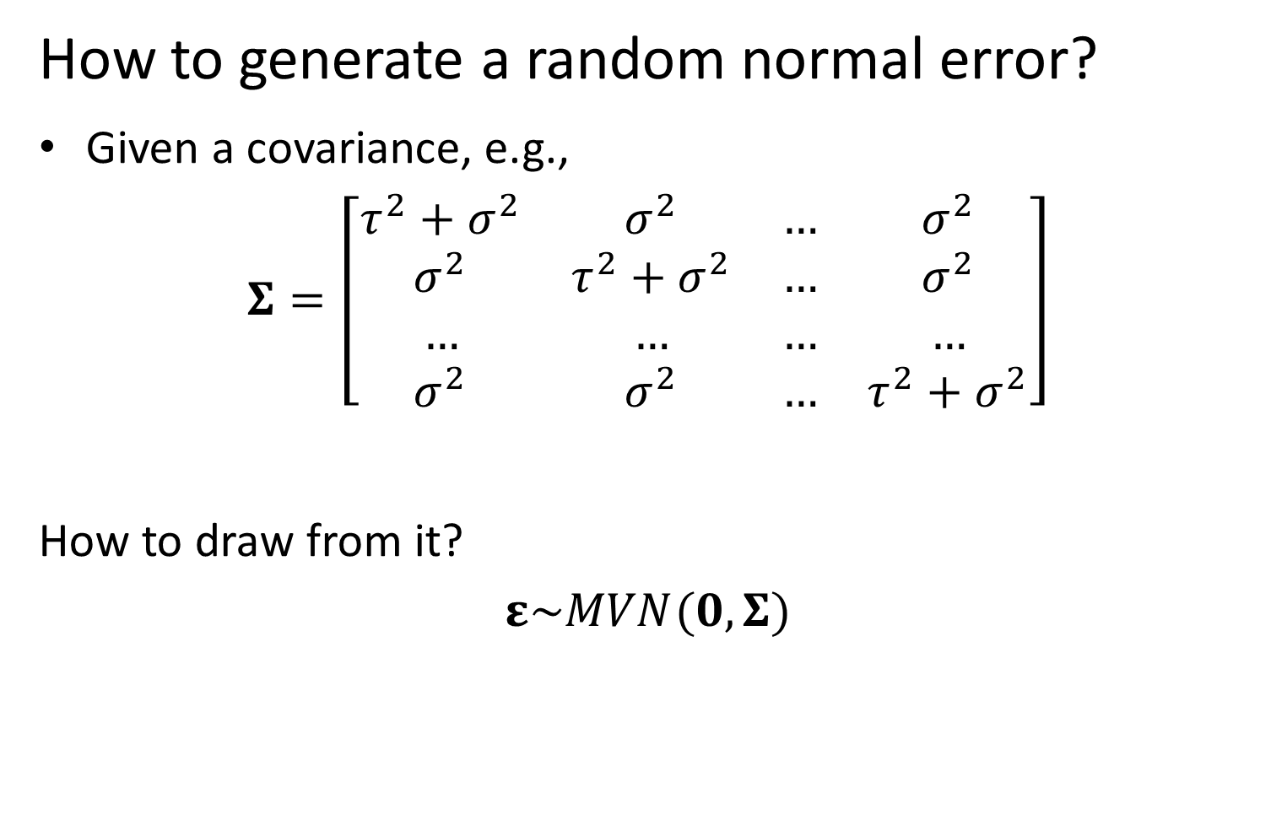
Multivariate models
How to generate a random normal error?
Given a covariance, e.g.,
$$Σ=\left[\begin{matrix}τ^{2}+σ^{2} & σ^{2} & … & σ^{2} \\ σ^{2} & τ^{2}+σ^{2} & … & σ^{2} \\ … & … & … & … \\ σ^{2} & σ^{2} & … & τ^{2}+σ^{2}\end{matrix}\right]$$
How to draw from it?
$$ε\sim MVN(0,Σ)$$
Notes:
Predicting rare/undersampled species, bycatch etc.

Slide 17

Multivariate models
Multivariate random walk
$$x_{t+1}\sim MVN(x_{t},Σ)$$
Where
$$Σ=τ^{2}I+σ^{2}11^{T}$$
$$σ^{2}=0.2$$
$$τ^{2}=0.5$$

